Slide 1
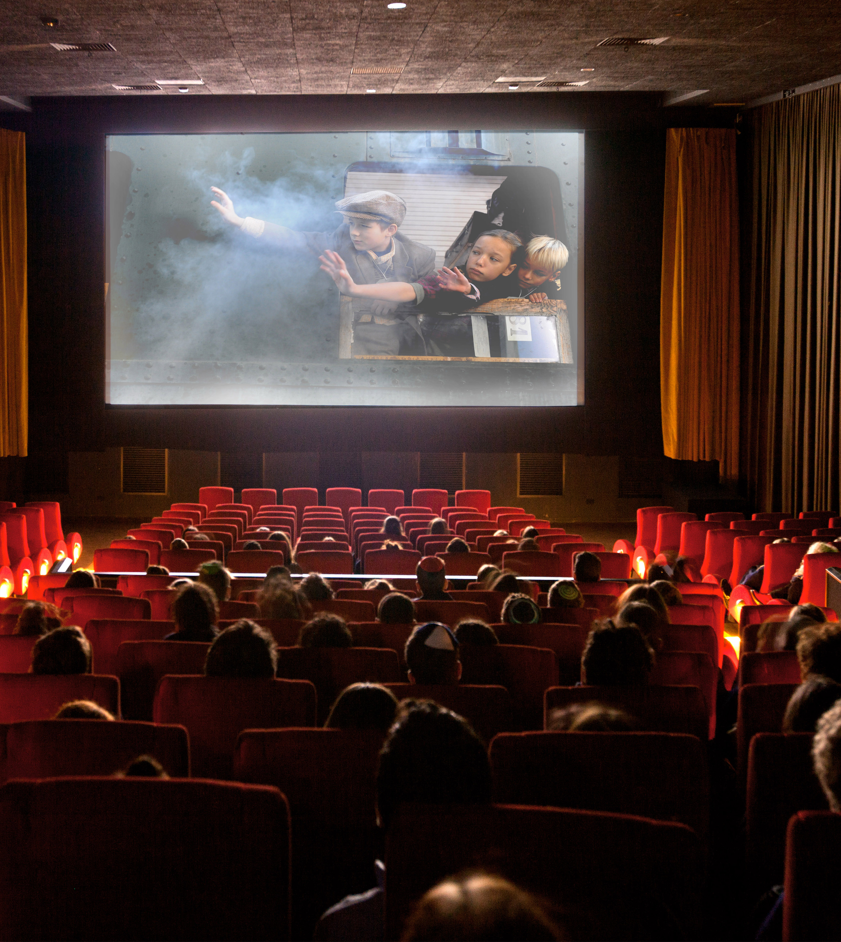

Cinem-AI
Data Mining and Machine Learning
Marco Bologna
Andrea Ruggieri

Slide 2
Project IDEA
Application goal:
Movie's revenue prediction
Dataset
Data Integration
Data Preprocessing
Regression Analysis
Classification Analysis
Data Discretization
Development of Classification models
Application Development

Slide 3
Dataset
Two biggest movie dataset available on the web:
IMDB Dataset: Main dataset for this study, has 23 features and around 80K observation
TMDB Dataset: Support Dataset used to fill missing values in the IMDB one
Unfortunately, the majority of observation had missing values for the revenue (target feature for this study)
Merging the two dataset on the IMDB code of the movie we achieved a starting collection of 20825 entries
External features added to the dataset:
Prizes informations for Actors, Directors, and Writers: number of previous nominations and wins of Oscar, Golden Globe, BAFTA, Emmy,
Number of previous film for Actors, Directors and Writers

Slide 4
Data Preprocessing
Data Cleaning
Useless features removal
Feature Engineering
Categorical: Chi-Squared Test
Numerical: Correlation Analysis
Null values
Categorical Features
One-Hot Encoding
Preprocessed dataset:
20705 rows (120 rows lost due to missing values)
87 columns (obtained via one hot encoding)
Chi-Squared → High similarity between Country and Language
Correlation → High correlation between prizes victory and nomination and between Oscars and Golden Globe
Final Dataset

Slide 5

Regression Analysis
MODEL SELECTION
FLAT CROSS VALIDATION
Pipeline steps:
Preprocessing: Standardization of numerical features
Feature selection: Keeps for the analysis the 20 best features
Model train and test
A Grid Search to find best parameters of each model was performed together within the cross validation
Then, each best model was trained with all the train set and evaluated over the test set

Slide 6
Result's evaluation
Models | Train Set |  |  |  | Test Set
 | R^2 | MAE | RMSE | MSE | R^2 | MAE | RMSE | MSE
AdaBoost | 0.456 | 81809219 | 214334476 | 4.59 | 0.39 | 85459858 | 213078427 | 4.54
Gradient Boosting | 0.528 | 77359532 | 199650305 | 3.98 | 0.36 | 83351584 | 218257105 | 4.76
KNN | 0.354 | 80122849 | 233574372 | 5.45 | 0.246 | 89388114 | 236898685 | 5.16
Decision Tree | 0.562 | 71758403 | 192282060 | 3.69 | 0.262 | 88080157 | 234341231 | 5.492
ElasticNet | 0.11 | 118242345 | 273842741 | 7.5 | 0.126 | 119316715 | 255072458 | 6.5
Random Forest | 0.684 | 58024217 | 163416971 | 2.67 | 0.418 | 85534253 | 208057585 | 4.39

Slide 7
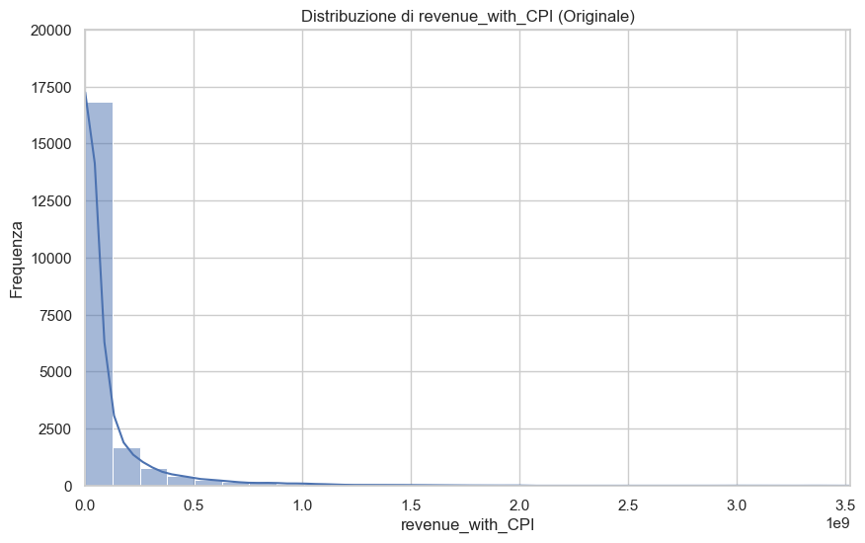
Data discretization
Classification Analysis
Due to the extremely skewed revenue, techniques as equal width or equal frequency discretization were excluded
Before the training of classification models, a data discretization step was needed to transform the revenues in classes of revenue
Cluster | From | To | Revenue
0 | 1.20 | 113087.1 | Low
1 | 113087.1 | 3452707.5 | Medium-Low
2 | 3452707.5 | 54779022.2 | Medium-High
3 | 54779022.2 | 8813184891.0 | High
K-Means Discretization also produces highly imbalanced clusters, so:
Transformation: A Log transformation was applied to the revenue to increase the normality of the distribution
Discretization: K-Means discretization over the transformed revenue

Slide 8
Classification Analysis
MODEL SELECTION
FLAT CROSS VALIDATION
Pipeline steps:
Oversampling: SMOTENC algorithm (can handle both numerical and categorical features)
Preprocessing: Standardization of numerical features and One-Hot Encoding of categorical features
Feature selection: Keeps for the analysis the 20 best features
Model train and test
For the model selection, as in regression, flat cross validation with grid search was used.
The pipeline is similar to the one used in regression task, but:
SMOTENC was adopted to rebalance the train set
One hot encoding was applied to Genre before SMOTENC and to the other categorical columns after
Synthetic samples with more than one genre could be created, but for the other columns only one option is possible (like in real observations)

Slide 9
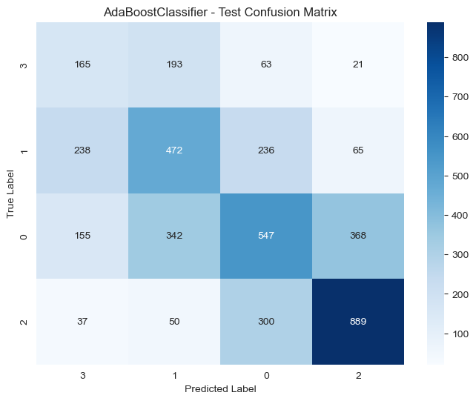
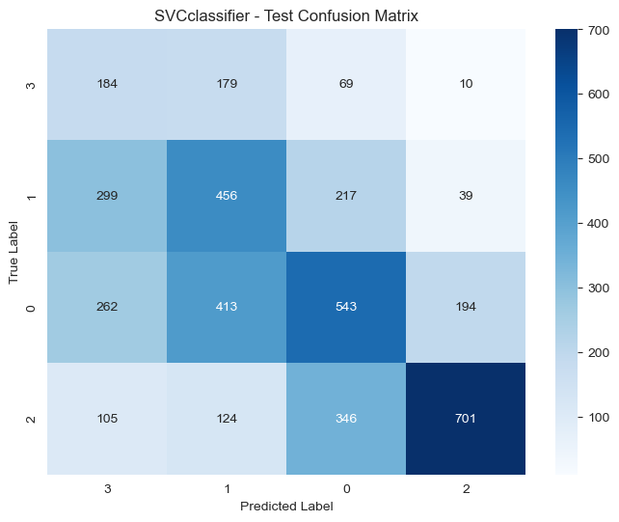
Result's Evaluation
Models | Train Set |  | Test Set
 | Accuracy | F1 | Accuracy | F1
AdaBoost | 0.507 | 0.507 | 0.5 | 0.5
Random Forest | 0.5545 | 0.5535 | 0.4894 | 0.4853
Logistic Regression | 0.4757 | 0.4605 | 0.4716 | 0.4529
KNN | 0.5812 | 0.5847 | 0.4658 | 0.4609
SVC | 0.4602 | 0.4758 | 0.4559 | 0.4701
Gaussian NB | 0.3281 | 0.3337 | 0.3298 | 0.3383

Slide 10
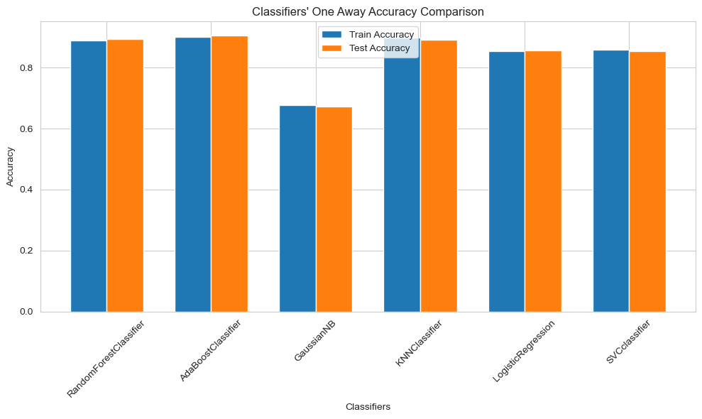
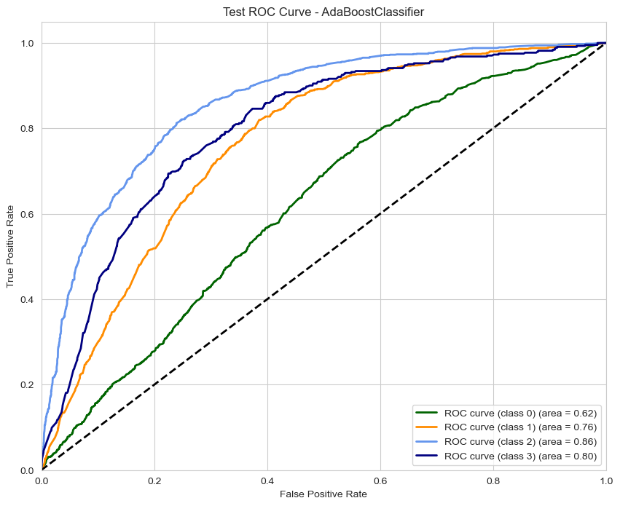
One Away Accuracy
AUC
One vs Rest

Slide 11
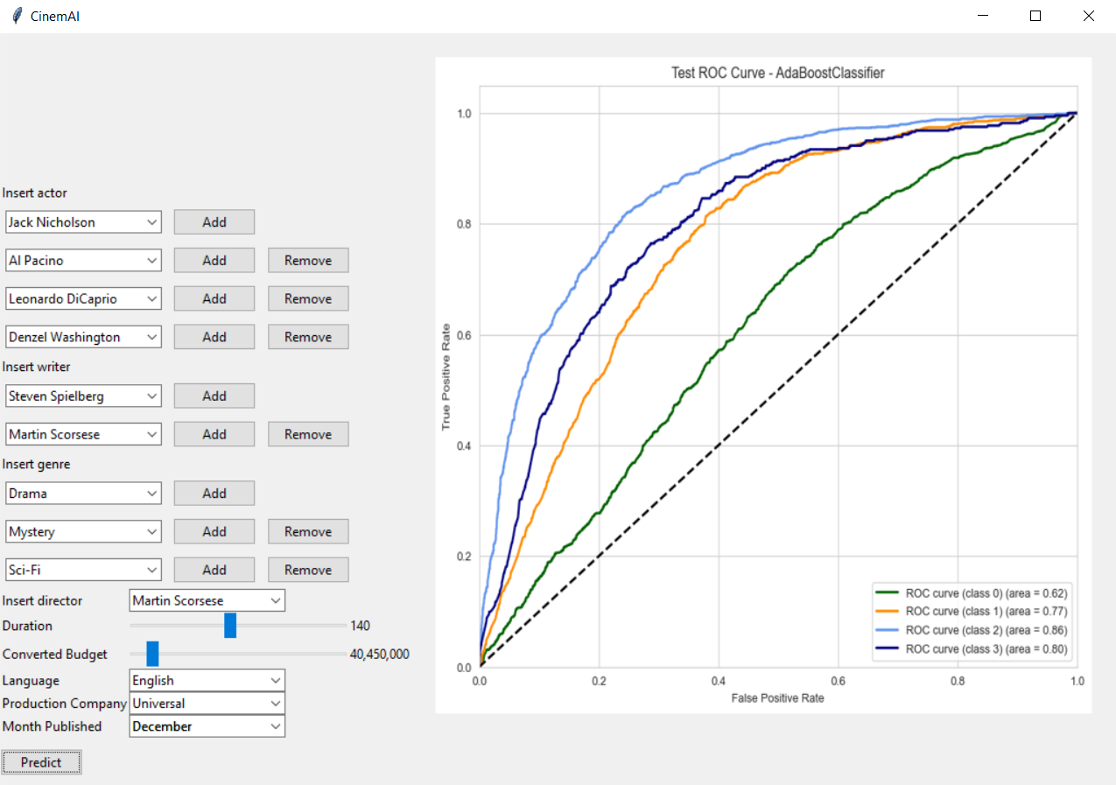
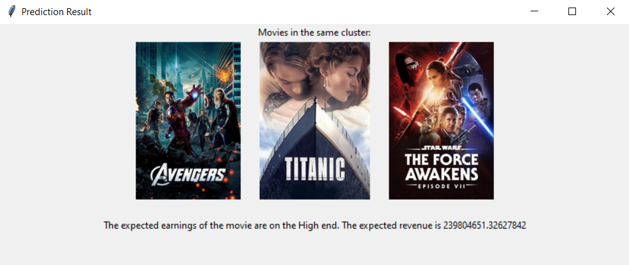
Conclusions
Regression Models
Least trustable, didn't get main part of the problem
Classification Models
AdaBoost seems efficient
All in all:
Unbalanced dataset
Difficult achieve higher results due to nature of the problem
Results obtained are comparable with the state of art of the problem

